Slide 1
Algorithmic Awareness
Presented by Jason Clark and Julian Kaptanian
Notes:
July 17th workshop for ACRL is scheduled
Presentation on June 29th at 9:00am
Julian

Slide 2
Outline
Who we are
Grant and things that went into this project
What is an Algorithm?
What is Algorithmic Awareness?
Algorithms in Action (screenshots + teaching tool demo)
Relation to ACRL Framework
How can we teach these concepts?
Breakout Session - Programming the Library
Questions
Notes:
Who we are: researchers from Montana State University Library Special Collections team
Grant: provided by the IMLS
Julian

Slide 3
About Us
Jason A. Clark
Associate Professor, Head of Archival Informatics and Special Collections, Montana State University
Julian Kaptanian
Research Assistant, History of Science and Technology Undergraduate Student
Tyler Bass
Research Assistant, Computer Science Undergraduate Student
Notes:
Who we are: researchers from Montana State University Library Special Collections team
Grant: provided by the IMLS
Julian

Slide 4
Grant Idea
We, and our patrons, routinely engage in systems that predict, recommend, and speculate about our interests based on the digital fingerprint we provide with our link clicks and “likes”, but we all struggle understanding how and why those systems work as they do.
IMLS Laura Bush 21st Century Librarian Program
Institute of Museum and Library Services
https://www.imls.gov/grants/awarded/re-72-17-0103-17
Notes:
Julian

Slide 5
Learning Objectives
Identify and define algorithms in action within common online interactions such as the sorting of a news feed, an eCommerce experience, and a search experience.
Learn how Algorithmic Awareness as a concept fits into the ACRL Framework
Apply session modules (released as OER) as actionable steps for teaching about algorithms in their own information literacy instruction
Notes:
Julian

Slide 6
Definitions
An algorithm is:
"a set of instructions that makes machines do something automatically according to a condition."
Notes:
Julian

Slide 7
Definitions (it’s complicated)
Can think of algorithms as a recipe: what are the ingredients (your inputs) and how are we preparing those to get a meal (the results)
If you put X into a function, what is Y? And why?
Matthew Reidsma claims a simple interpretation of a complex idea perpetuates misunderstanding. Instead, he claims, algorithms should be viewed as a large set of binary choices that create a "decision tree" based upon many variables that are not necessarily apparent to the user.
Notes:
Julian

Slide 8
Definitions Cont.
Algorithmic Awareness
“an understanding around the rules that govern our software and shape our digital experiences”
Notes:
Julian

Slide 9
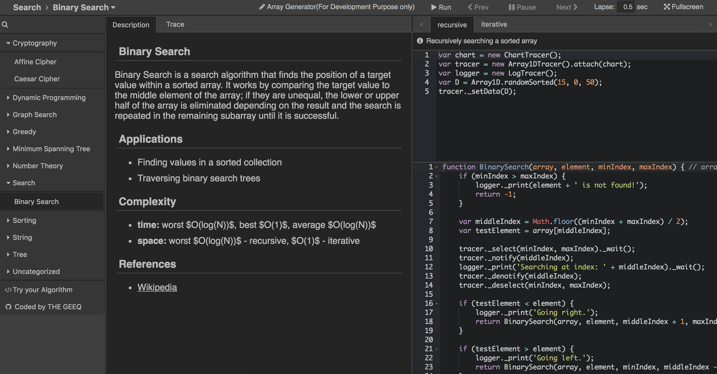
Algorithms are Complex
http://algonimator.thegeeq.gq/
Notes:
Julian

Slide 10
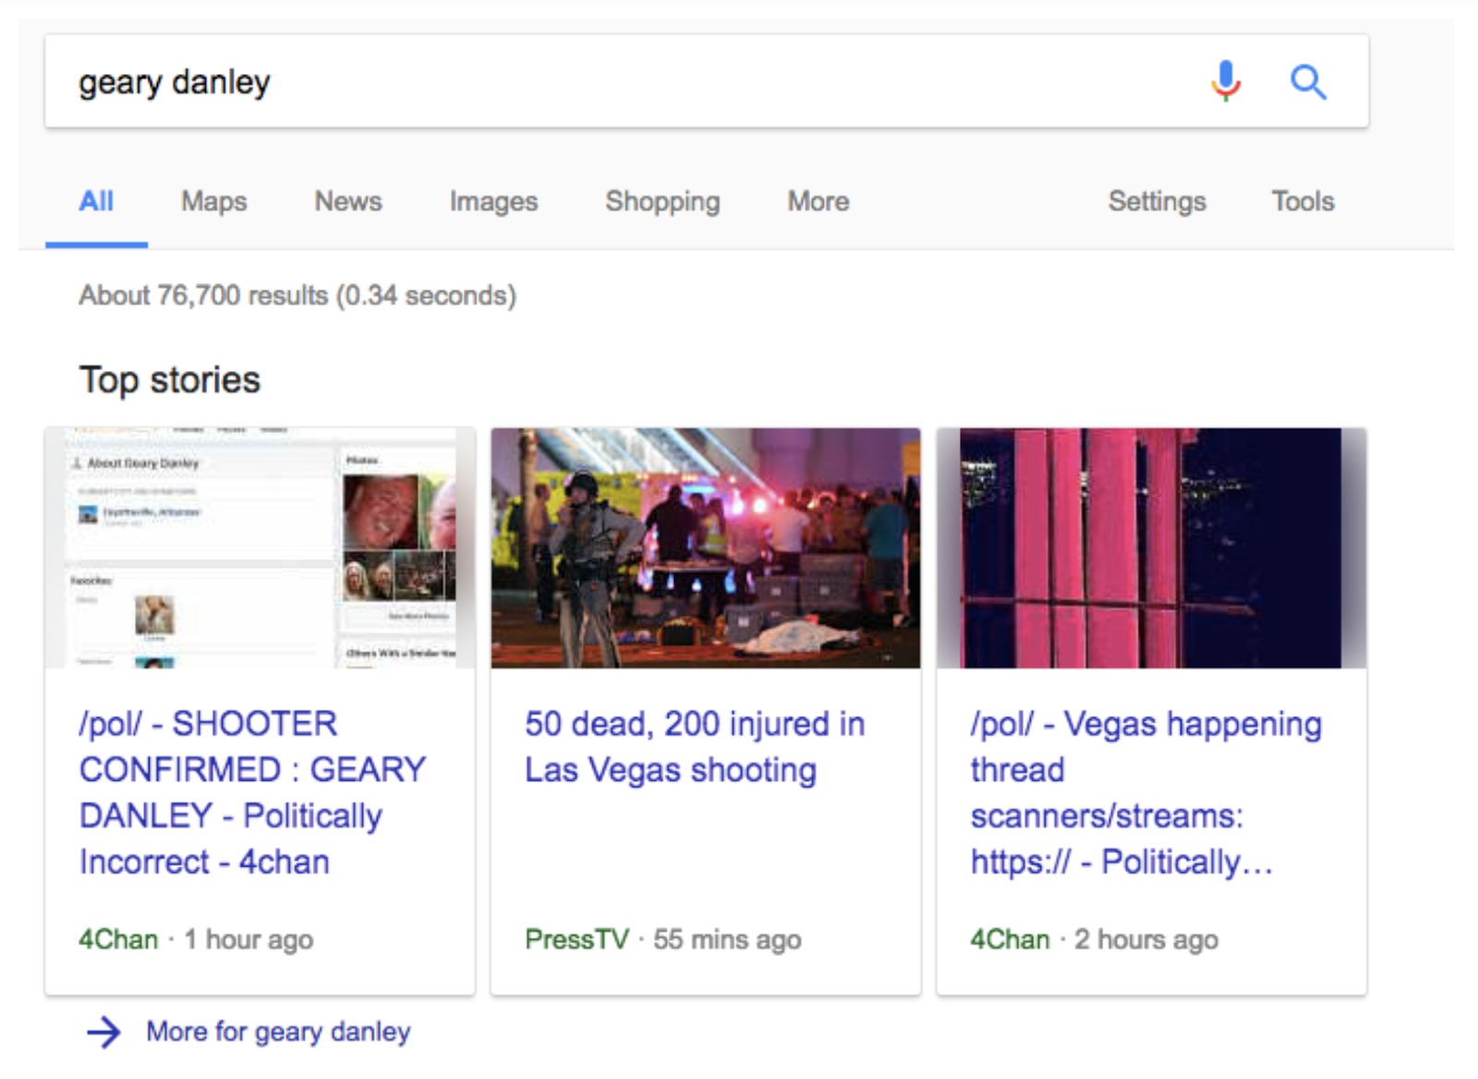
Algorithms have Material Consequences
Notes:
Julian

Slide 11
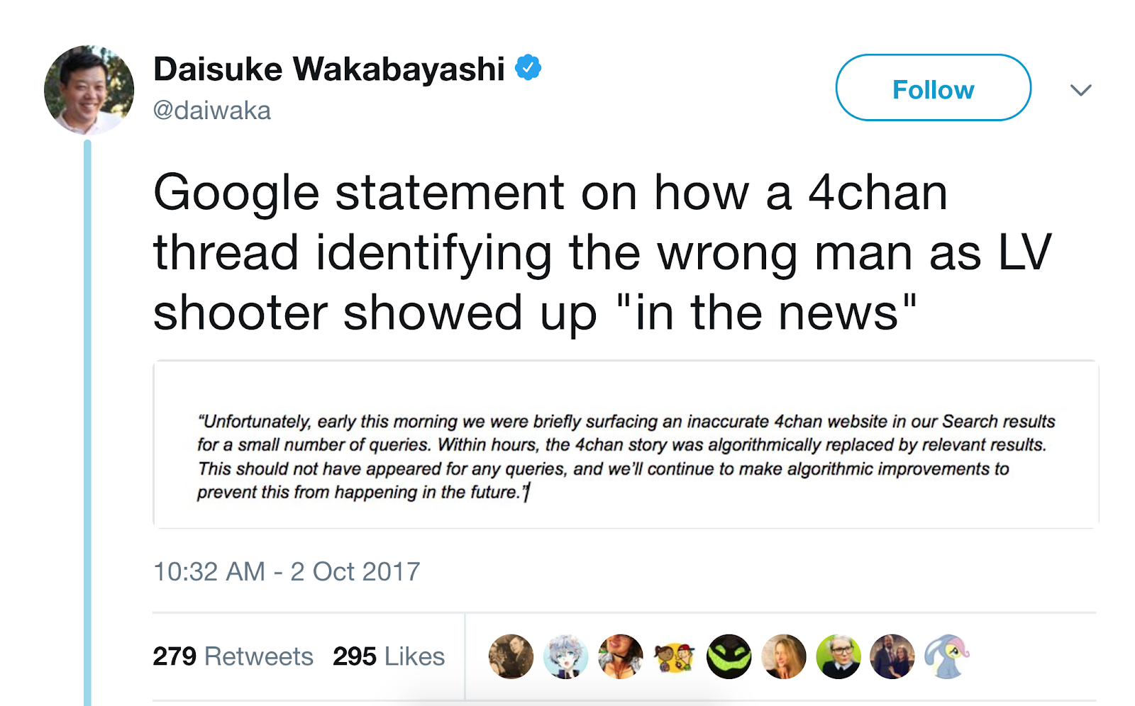
Algorithms have Material Consequences
Notes:
Julian

Slide 12
Awareness Outside Our Field
Statement on Algorithmic Transparency and Accountability (ACM)
https://www.acm.org/binaries/content/assets/public-policy/2017_usacm_statement_algorithms.pdf
Notes:
Julian

Slide 13
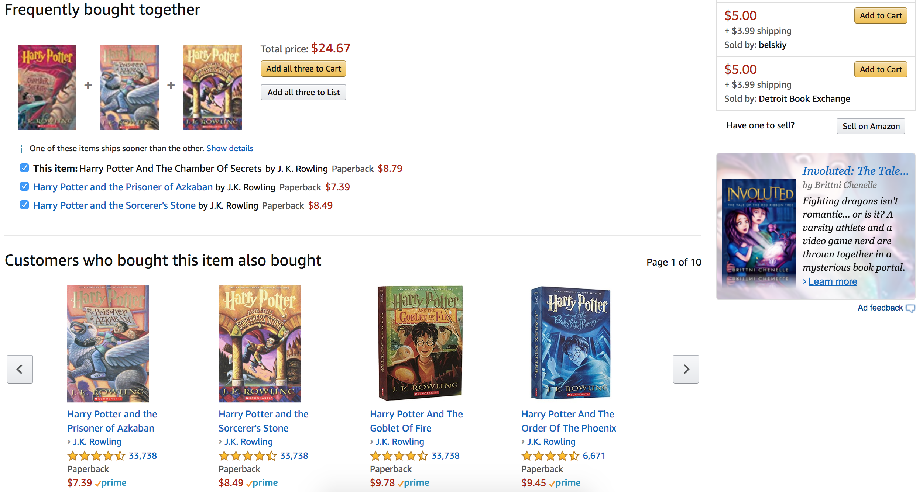
Notes:
Factors that may influence:
Previous purchases, the most popular purchases, related items, advertisements?
Jason

Slide 14
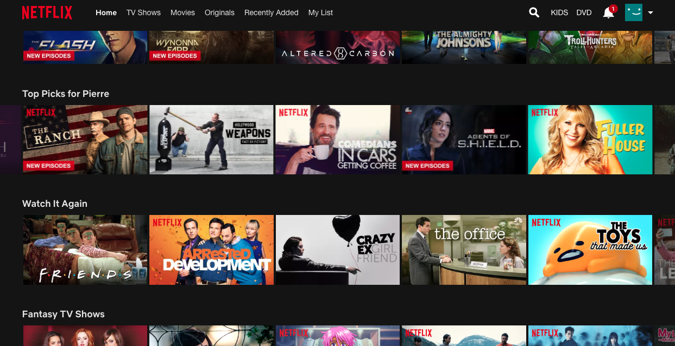
Notes:
Top Picks:
Factors that may influence- genre, actors, previously watched movies, common actors, push for Netflix Originals
Jason

Slide 15
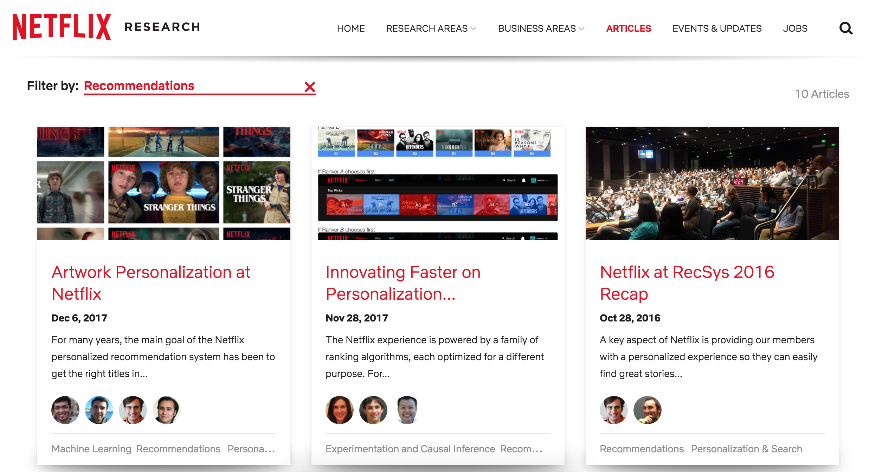
https://research.netflix.com/articles?q=Recommendations
Notes:
Top Picks:
Factors that may influence- genre, actors, previously watched movies, common actors, push for Netflix Originals
Jason

Slide 16
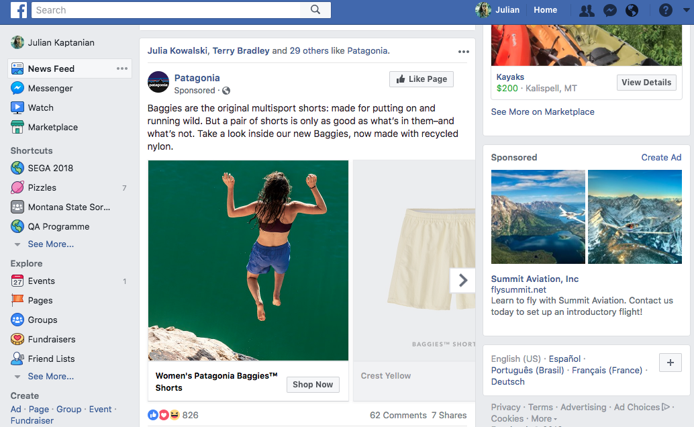
Notes:
Facebook Advertisements:
Factors that may influence: Previous searches (in my case, I was looking into hiking trails for this 4th of July weekend), what your friends like (ie, julia, terry, and 29 others), where you live/your zip code (recreation, Kalispell sales-where I'm originally from and where most of my friends are from), where your friends are from
Jason

Slide 17
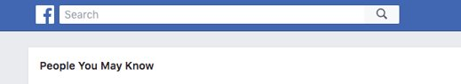
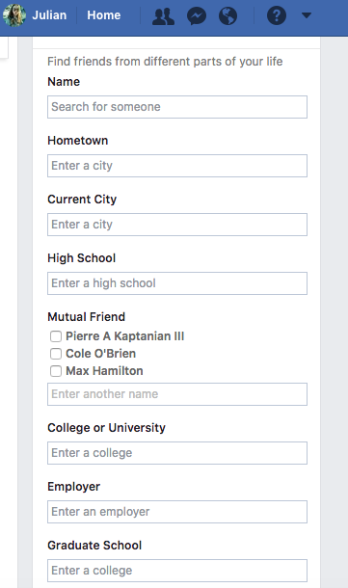
Notes:
Name, hometown, current city, high school, mutual friends, college or university, employer, graduate school, age, phone/other social media contacts
Jason

Slide 18
Algorithms in Action
Weighted Graph Network
https://en.wikipedia.org/wiki/Weighted_network
Dijkstra's algorithm
https://en.wikipedia.org/wiki/Dijkstra%27s_algorithm
Notes:
Julian

Slide 19
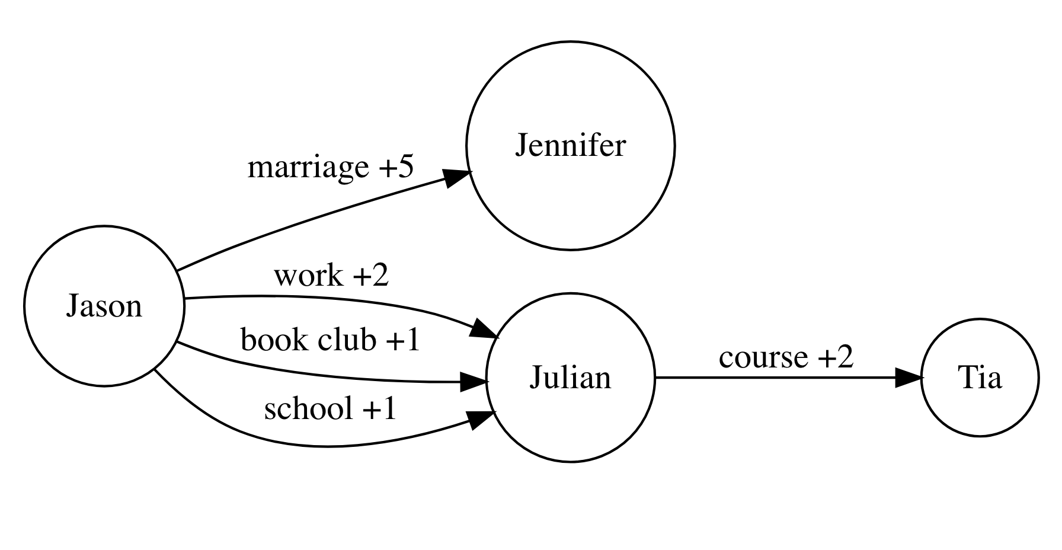
Notes:
Name, hometown, current city, high school, mutual friends, college or university, employer, graduate school, age, phone/other social media contacts
Jason

Slide 20
Teaching Tool
an "X-Ray" type search interface that demonstrates how different factors affect your search results
Location, weather, what else might be silently influencing?
E-Commerce experience: how likely are you to buy and what price do you see?
Implications
Notes:
We might want to include this if it's up and running! Cool demonstration
From WMD- the way someone sees prices depends on how likely they are to buy the product. For example, an airline ticket. If you've looked at a trip to Hawaii three times, are you more likely to buy now that you've been researching it? Perhaps you're more committed now and perhaps a bump up in price might be the factor that tips the scale so you buy before it's too close to the date you have a free weekend.
Another example of real world influence is US Today College ranking.
Jason

Slide 21
Teaching Tool (cont.)
an "X-Ray" type search interface that demonstrates how different factors affect your search results
Demo Application
Code for Demo Application
Notes:
We might want to include this if it's up and running! Cool demonstration
From WMD- the way someone sees prices depends on how likely they are to buy the product. For example, an airline ticket. If you've looked at a trip to Hawaii three times, are you more likely to buy now that you've been researching it? Perhaps you're more committed now and perhaps a bump up in price might be the factor that tips the scale so you buy before it's too close to the date you have a free weekend.
Another example of real world influence is US Today College ranking.
Jason

Slide 22
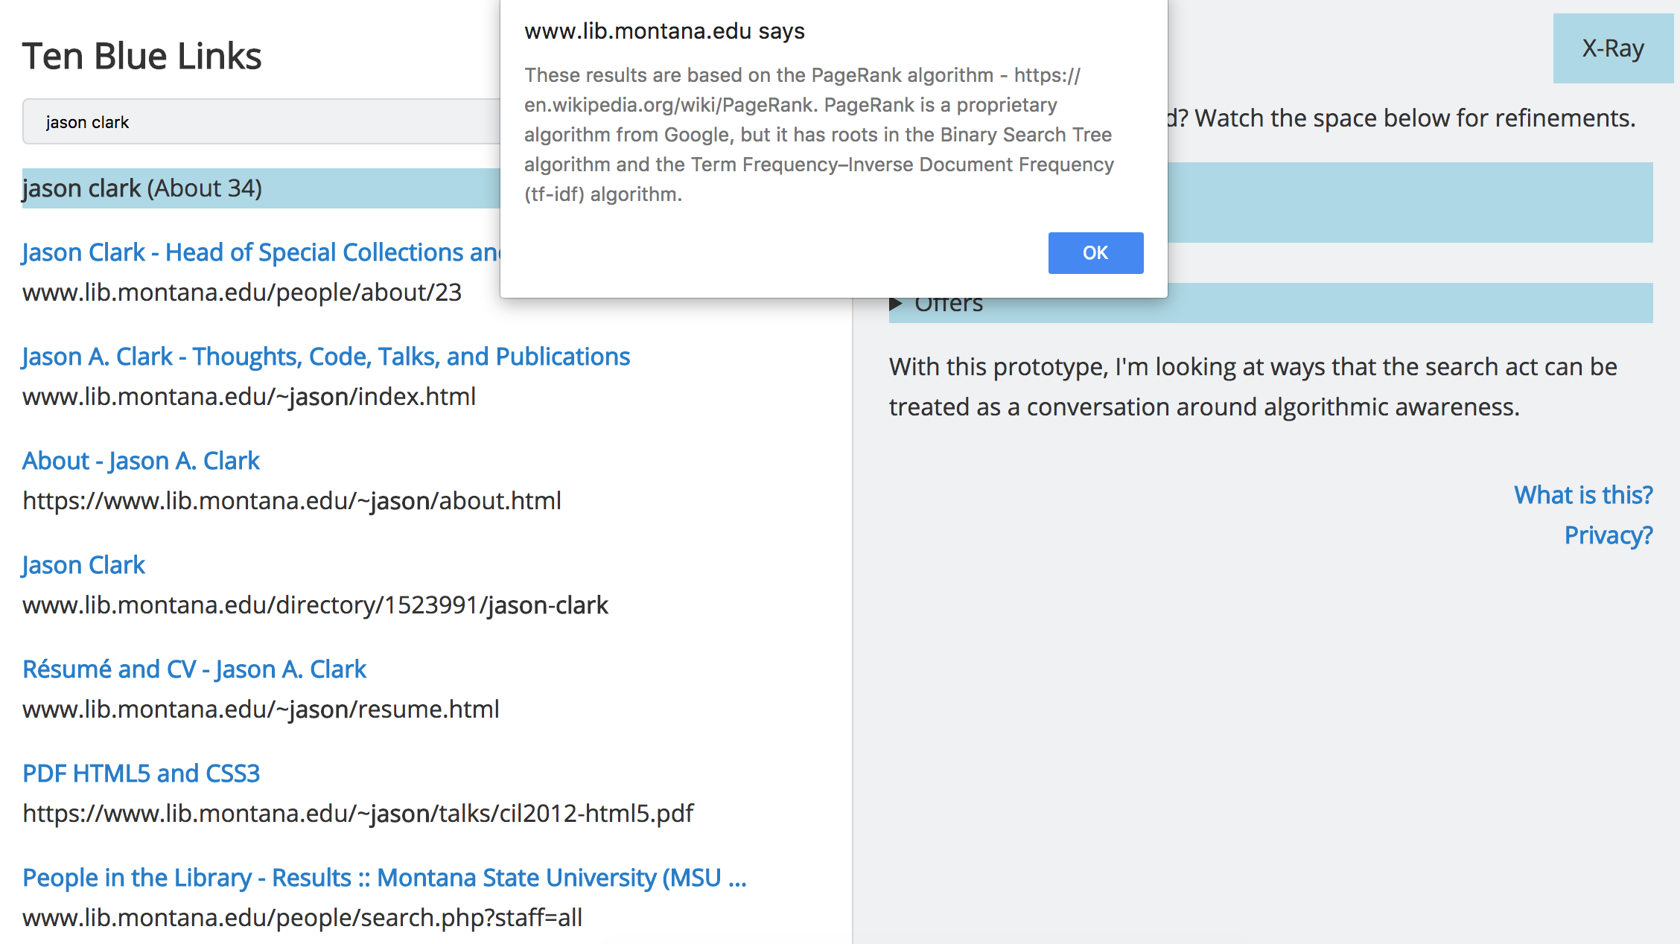
Notes:
Jason

Slide 23
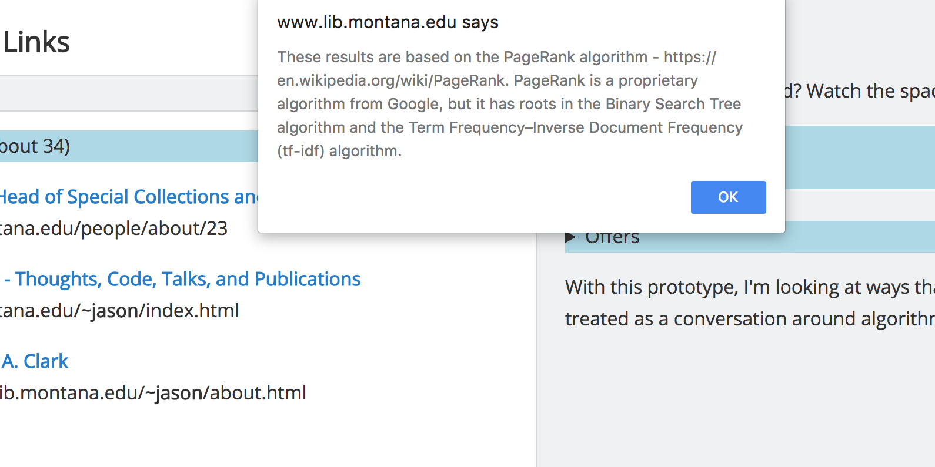
Notes:
Jason

Slide 24
ACRL Framework
Authority Is Constructed and Contextual
Information Creation as a Process
Information Has Value
Research as Inquiry
Scholarship as Conversation
Searching as Strategic Exploration
Notes:
Jason

Slide 25
ACRL Framework
Authority Is Constructed and Contextual
"Information resources reflect their creators’ expertise and credibility, and are evaluated based on the information need and the context in which the information will be used. Authority is constructed in that various communities may recognize different types of authority. It is contextual in that the information need may help to determine the level of authority required."
Algorithms = a “creator” informed by human decisions
Notes:
Jason

Slide 26
How Can we Teach These?
Create Reference Materials
Practice “Algorithmic Thinking”
Build Tools with algorithmic transparency in mind
Establish “algorithmic awareness” as a digital competency
Notes:
Julian

Slide 27
How Can we Teach These?
Deliverables
White Paper
Syllabus
Set definition of an algorithm
Set of documents that explain the breakout sessions
Pseudo code example
Reading list
Upcoming workshops
Local Library Workshops
ACRL Webinar- "Unpacking the Algorithms That Shape Our UX: Algorithmic Awareness as a Form of Information Literacy
Learn @DLF Presentation
Notes:
Julian

Slide 28
Break-Out Session: Programming the Library
Introduction:
We are going to ask you to program the different goals and actions of a library.
We will be practicing by putting these expressions into a computer program using a pseudo code language.
Teaching moment: This exercise will provide a theorized example of the workings of an algorithm. In addition, it will give an introduction to coding with a balance between technical and comprehensive learning.
Notes:
Julian

Slide 29
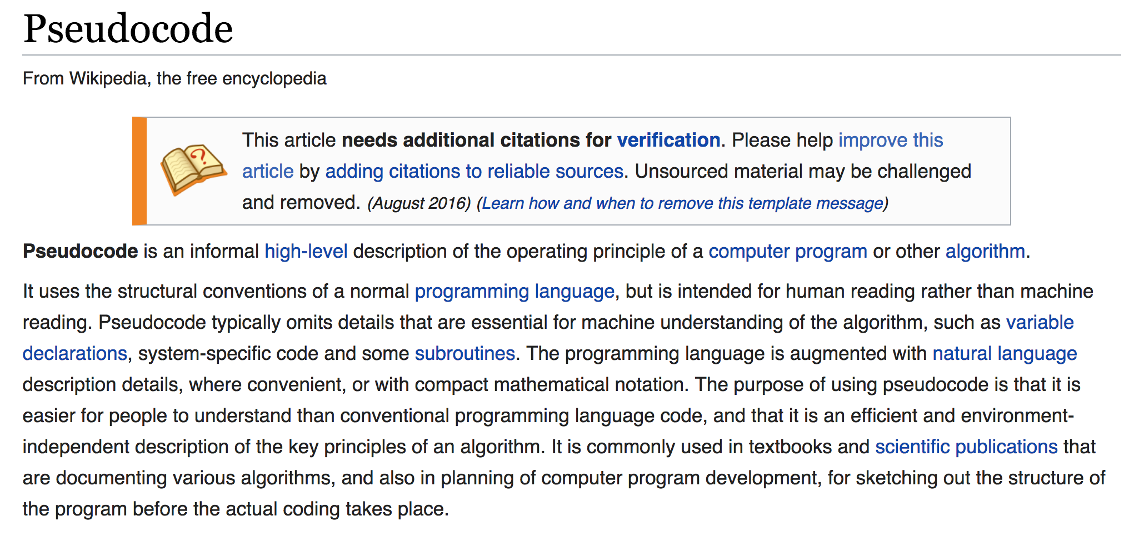
https://en.wikipedia.org/wiki/Pseudocode
Notes:
Julian

Slide 30
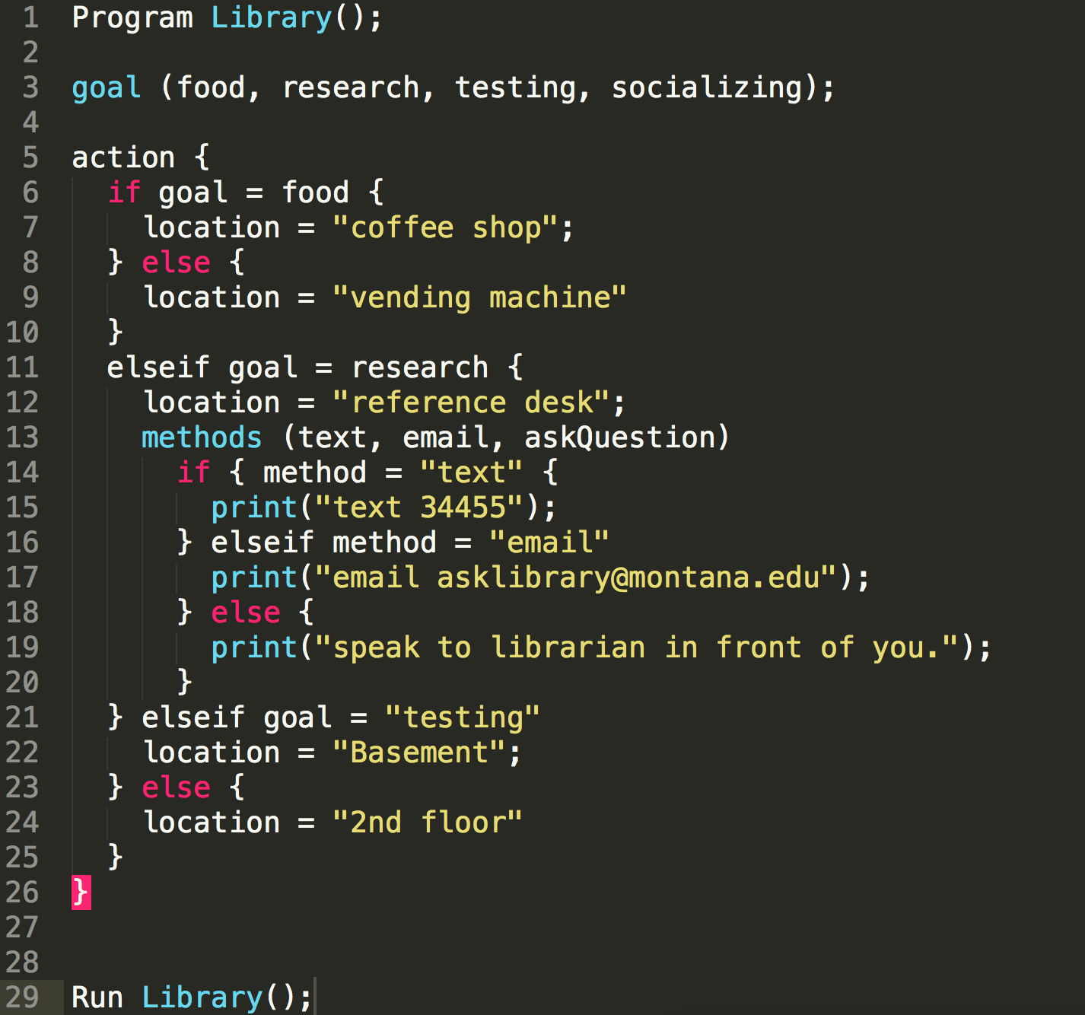
Notes:
Julian

Slide 31
Breakout Session: Steps
Open​ PseudoCode template in text editor
Work through adding values and encoding decisions individually.
One goal is complex​, you will need to add methods.
Come back together to discuss.
Notes:
Jason

Slide 32
Discussion
Answer the questions
What were some of your goals?​
How did you decide on your locations and actions?​
How do you view the role of a programmer and what are some of the challenges they may face when creating algorithms?​
How is the algorithm different from human direction?​
How do you see bias in the algorithm you created?
Notes:
Jason

Slide 33
Session Module (released as OER)
Module 1 released
Slides
Breakout Session (Instructions + Pseudocode)
Teaching Tool
Reading List
https://github.com/jasonclark/algorithmic-awareness/tree/master/modules
Notes:
Jason

Slide 34
Questions?
Comments? Survey?
Notes:
Jason
Class Poll
What did you enjoy/find most educational about the class?
What could be change/improved upon in the next class?
What would you be most interested in learning about algorithms in the future?
What did you learn about algorithms?
Do you feel confident you could teach another person what an algorithm is?
clarity and organization
What class exercises worked best?
What class exercises did not work well?
Add survey questions: what class exercises worked best? What did not work well?

Slide 35
Class Survey
What did you enjoy/find most educational about the class?
What could be changed/improved upon in the next class?
What would you be most interested in learning about algorithms in the future?
What did you learn about algorithms?
Do you feel confident you could teach another person what an algorithm is?
Was the class clear and organized?
What did you think of the class exercise?

